Slide 1
20221012 Learning Python
Python List
4110E230

Slide 2
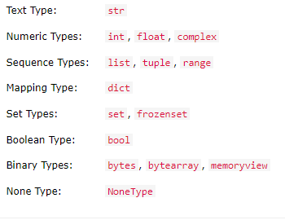
Python Data Type List
In programming, data type is an important concept.
Variables can store data of different types, and different types can do different things.
Python has the following data types built-in by default, in these categories:

Slide 3
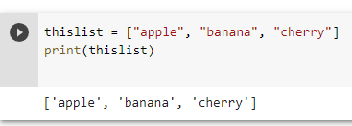
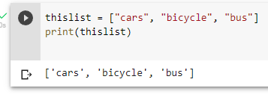
Python List
LIST
-Lists are used to store multiple items in a single variable.
-Lists are one of 4 built-in data types in Python used to store collections of data, the other 3 are Tuple, Set, and Dictionary, all with different qualities and usage.
-Lists are created using square brackets:

Slide 4
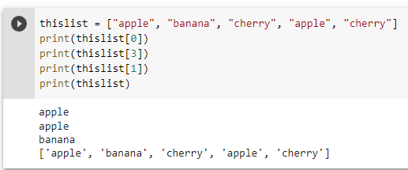
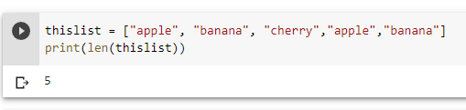
Python List
Allow Duplicates
-Since lists are indexed, lists can have items with the same value:
List Length
-To determine how many items a list has, use the len() function:

Slide 5
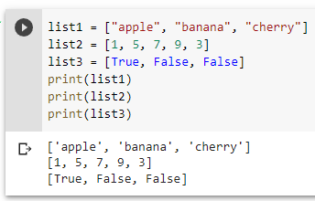
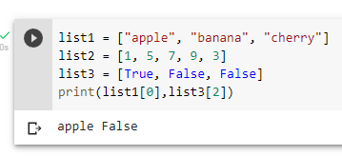
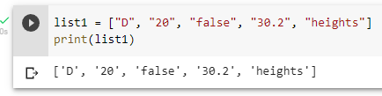
Python List
List Items - Data Types
-A list can contain different data types:

Slide 6
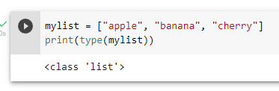
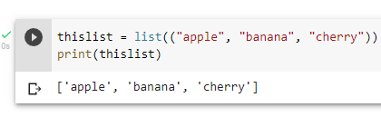
Python List
TYPE()
-From Python's perspective, lists are defined as objects with the data type 'list':
The list() Constructor
-It is also possible to use the list() constructor when creating a new list.
-Using the list() constructor to make a List:

Slide 7
Python Basic List Operator

Slide 8
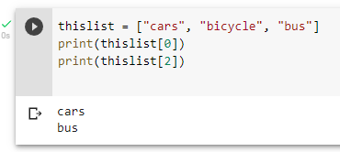
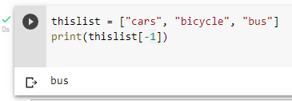
Python- Access List Items
Access Items
List items are indexed and you can access them by referring to the index number:
Negative Indexing
Negative indexing means start from the end
-1 refers to the last item, -2 refers to the second last item etc.

Slide 9
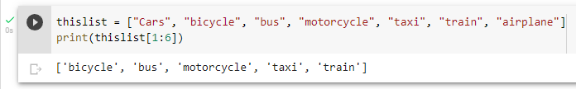
Python- Access List Items
Range of Indexes
You can specify a range of indexes by specifying where to start and where to end the range.
When specifying a range, the return value will be a new list with the specified items.

Slide 10
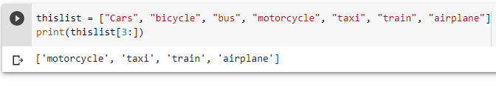
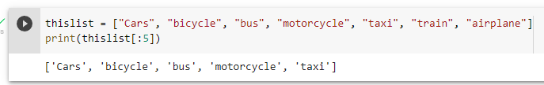
Python- Access List Items
Range of Indexes
This example returns the items from “motorcycle" to the end:
This example returns the items from the beginning to, but NOT including, “trian":

Slide 11
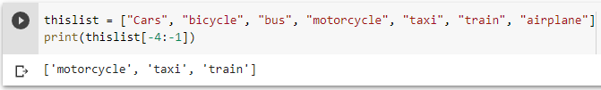
Python- Access List Items
Range of Negative Indexes
Specify negative indexes if you want to start the search from the end of the list:
This example returns the items from “motorcycle" (-4) to, but NOT including “airplanes" (-1):

Slide 12
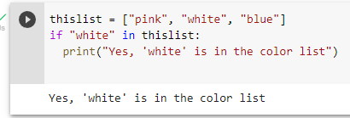
Python- Access List Items
Check if Item Exists
To determine if a specified item is present in a list use the in keyword
Check if “white" is present in the list:

Slide 13
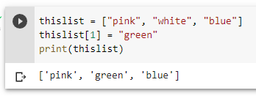
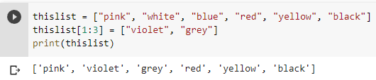
Python- Change List Items
Change Item Value
To change the value of a specific item, refer to the index number:
Change a Range of Item Values
To change the value of items within a specific range, define a list with the new values, and refer to the range of index numbers where you want to insert the new values:

Slide 14
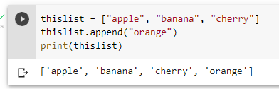
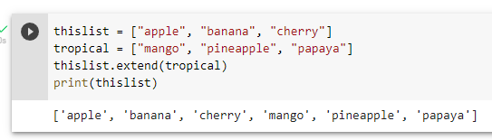
Python- Add List Items
Append Items
To add an item to the end of the list, use the append() method:
Extend List
To append elements from another list to the current list, use the extend() method.

Slide 15
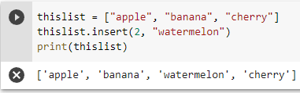
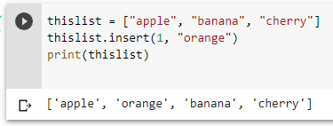
Python- Add List Items
Insert Items
To insert a list item at a specified index, use the insert() method.
The insert() method inserts an item at the specified index:

Slide 16
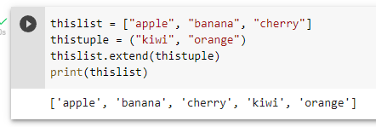
Python- Add List Items
Add Any Iterable
The extend() method does not have to append lists, you can add any iterable object (tuples, sets, dictionaries etc.).

Slide 17
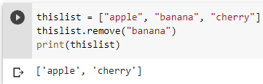
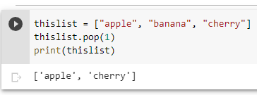
Python- Remove List Items
Remove Specified Item
The remove() method removes the specified item.
Remove Specified Index
The pop() method removes the specified index.

Slide 18
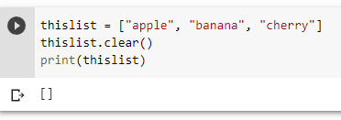
Python- Remove List Items
Clear the List
The clear() method empties the list.
The list still remains, but it has no content.

Slide 19
Advance Operation in Python List

Slide 20
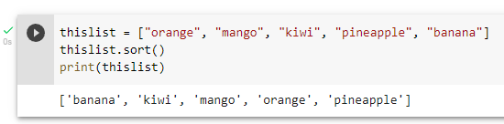
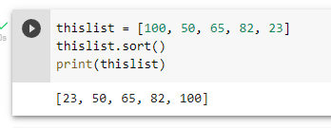
Sort List
Sort List Alphanumerically
List objects have a sort() method that will sort the list alphanumerically, ascending, by default:

Slide 21
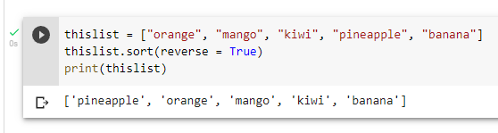
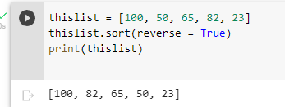
Sort List
Sort Descending
To sort descending, use the keyword argument reverse = True:

Slide 22
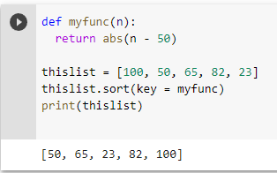
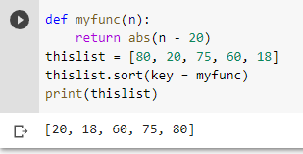
Sort List
Customize Sort Function
You can also customize your own function by using the keyword argument key = function.
The function will return a number that will be used to sort the list (the lowest number first):

Slide 23
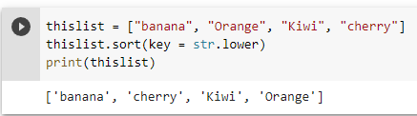
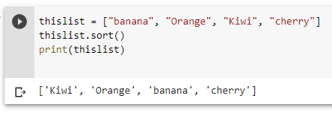
Sort List
Case Insensitive Sort
By default the sort() method is case sensitive, resulting in all capital letters being sorted before lower case letters:

Slide 24
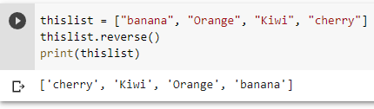
Sort List
Reverse Order
What if you want to reverse the order of a list, regardless of the alphabet?
The reverse() method reverses the current sorting order of the elements.

Slide 25
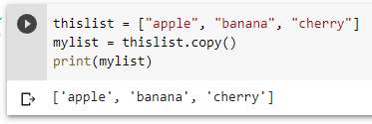
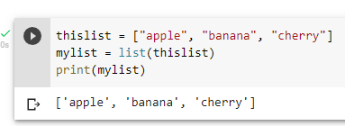
Copy List
Copy a List
You cannot copy a list simply by typing list2 = list1, because: list2 will only be a reference to list1, and changes made in list1 will automatically also be made in list2.

Slide 26
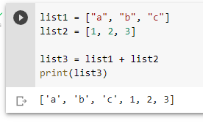
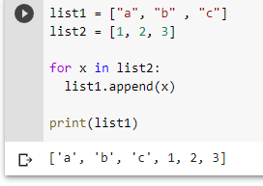
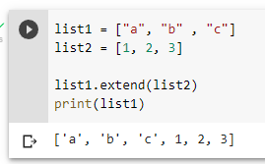
Join List
Join Two Lists
There are several ways to join, or concatenate, two or more lists in Python.
One of the easiest ways are by using the + operator.

Slide 27
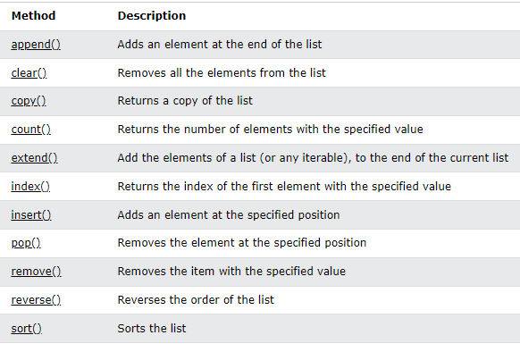
Python List Methods
List Methods
Python has a set of built-in methods that you can use on lists.

Slide 28
CHINESE NAME: 彭哈帕
STUDENT ID: 4110E230
ENGLISH NAME: James Ryan H. Pregon
NICKNAME: Kaori
Email: jamesryanpregon@gmail.com
GITHUB: https://github.com/PengHaPa/cs2022.git
谢谢你

